Slide 1
Qu’est-ce Spotty aime faire?
What does Spotty like doing?
Images: pixabay.com
© frenchteacher.net

Slide 2
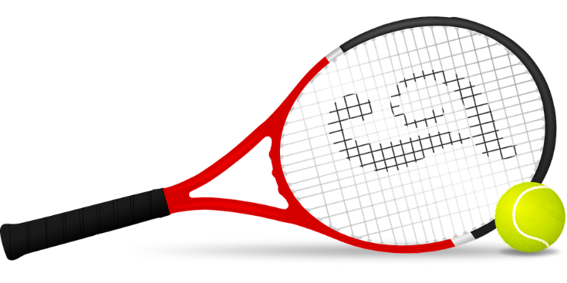

Il aime jouer au tennis

Slide 3
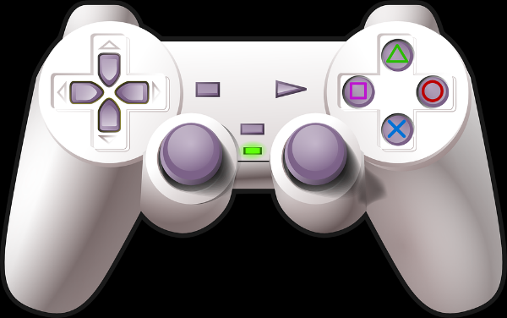

Il aime jouer à des jeux vidéo

Slide 4
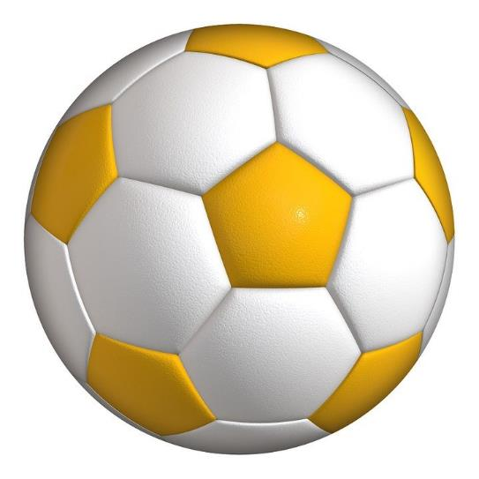
Il aime jouer au football

Slide 5


Il adore regarder la télé

Slide 6

Il aime écouter de la musique

Slide 7
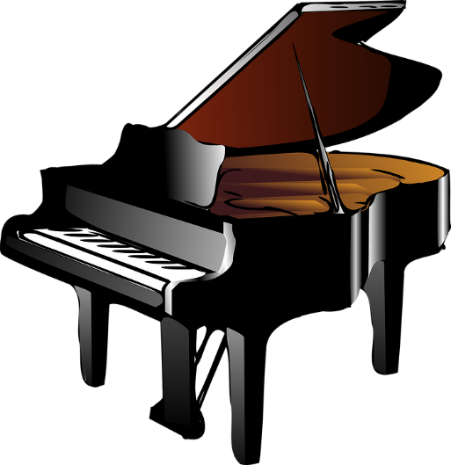

Il aime beaucoup jouer
du piano

Slide 8

Il aime regarder des vidéos

Slide 9

Il aime manger du popcorn

Slide 10
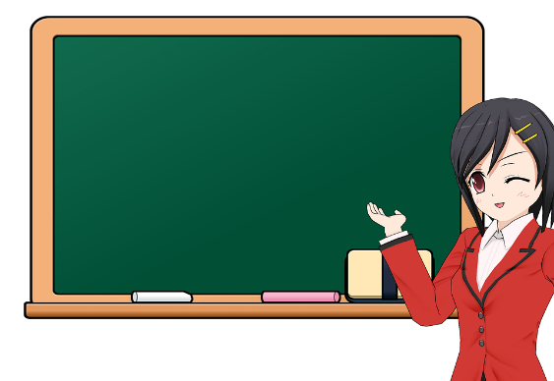
Il aime écouter la professeure

Slide 11

Il adore acheter
des provisions

Slide 12
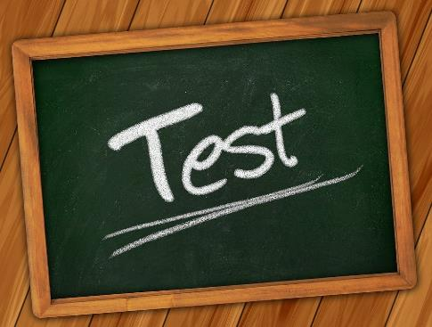
Il aime réviser pour
un examen

Slide 13
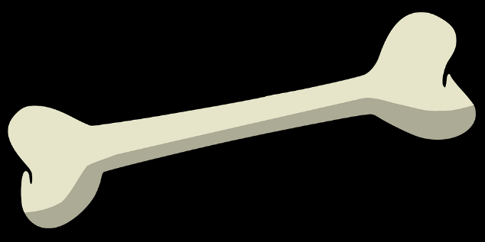
Il aime beaucoup manger un os

Slide 14
Ecoutez encore une fois, regardez les mots et répétez

Slide 15
Il aime jouer au tennis

Slide 16
Il aime jouer à des jeux vidéo

Slide 17
Il aime jouer au football

Slide 18
Il adore regarder la télé

Slide 19
Il aime écouter de la musique

Slide 20
Il aime beaucoup jouer du piano

Slide 21
Il aime regarder des vidéos

Slide 22
Il aime manger du popcorn

Slide 23
Il aime écouter la professeure

Slide 24
Il adore acheter
des provisions

Slide 25
Il aime réviser pour
un examen

Slide 26
Il aime beaucoup manger un os

Slide 27







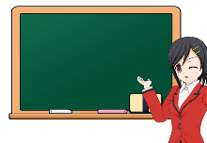





Slide 28
Comment-dit on en français?
He likes to play tennis
He likes playing football
He loves to play the piano
He likes to watch TV
He loves watching videos
He likes to listen to music
7. He loves eating a bone
8. He likes to buy groceries
9. He likes listening to the teacher
10. He loves to eat popcorn
11. He likes revising for an exam

Slide 29
Memory test!
How many of those sentences can do from memory?
With a partner, take turns and the first person who cannot give an example is the loser.

Slide 30
Guessing game
In pairs, your partner has to think of a pastime from the list. You have to guess by asking yes/no questions
e.g. Il aime jouer au tennis?
Il aime regarder la télé?
Il aime réviser pour un examen?

Slide 31
How long can you keep talking?
See how long you can keep describing pastimes while your partner times you.
Could you make up any more adapting the language you have already practised or what you knew before?
To help: Il aime jouer… Il aime regarder…

Slide 32
Two verbs together
Il aime jouer
= He likes to play/playing
The first verb is called the MAIN VERB
The second verb is in the INFINITIVE (ends –er here)
RULE: when two verbs go together, the second one is in the infinitive.
Make up some examples.

